Slide 1

Carrier On Time Performance Analysis
Drexel University LeBow College of Business
Summer 2023
Team 3
Swati Mambilavil
Alfreda Adote
Taha Talwala
Jozil Jacob

Slide 2
Project Summary
Business problem
Methodology & Tools Used
Exploratory Data Analysis (Understanding the data)
Model building & evaluation
Conclusion
Findings & insights
Model limitations
Recommendations
Appendix
2

Slide 3
Business Problem
Background:
Arrival performance is critical for the economic success of airlines and the satisfaction of their customers.
Airlines need the proper insight to improve performance, retain customers and remain competitive.
Problem Statement:
Amongst the different variables in the dataset, we will be focusing on essential features like Operating Airline, Wheels On time, Wheels Off time, Taxi Out time, Taxi In time, The Arrival Time and Departure Time, and will be predicting the Arrival delays.
Objectives & Research Questions
Which airlines are the most likely to have delays?
Which airports experienced the most delays?
Are there unique trends in airlines’ arrival performance over the years?
3

Slide 4
Methodology and Tools used
Data source:
• https://www.transtats.bts.gov/DL_SelectFields.aspx?gnoyr_VQ=FGK&QO_fu146_anzr=b0-gvzr
Data content:
•Flight Delay data from January 2018- April 2023.(36030935 rows x 119 columns)
•All airlines and their arrival delay performance for operating airlines
Data Preparation/Cleaning:
•Null values handling
•Identifying outliers and their impact on the data
Data Merging:
•Database was created to combine all the data
Data Analysis Tools:
SQL, Microsoft Excel, Tableau, Python
4

Slide 5
Key Highlights for EDA
Steps we performed to get a focused data set:
1) Collate the data such that the analysis can be focused on only small airlines
2) We filtered out the flights which have been cancelled:
Reason: No arrival delay data as the flight itself changes.
3) We next filtered out the flights that have been diverted:
Reason: Since diversion delay data was not present and we are not considering it to be part of our analysis.
4) We then looked at fields with all NULL values and removed them at the filtering stage.
Fields like: Cancellation Code, DivAirport Landings, DivReachedDest, DivActualElapsedTime, DivArrDelay, DivDistance, Div1Airport, Div1AirportID to name a few.
5) We also filtered out the data as pre-covid, and post-covid and then merged them, excluding data from 2020.
5

Slide 6
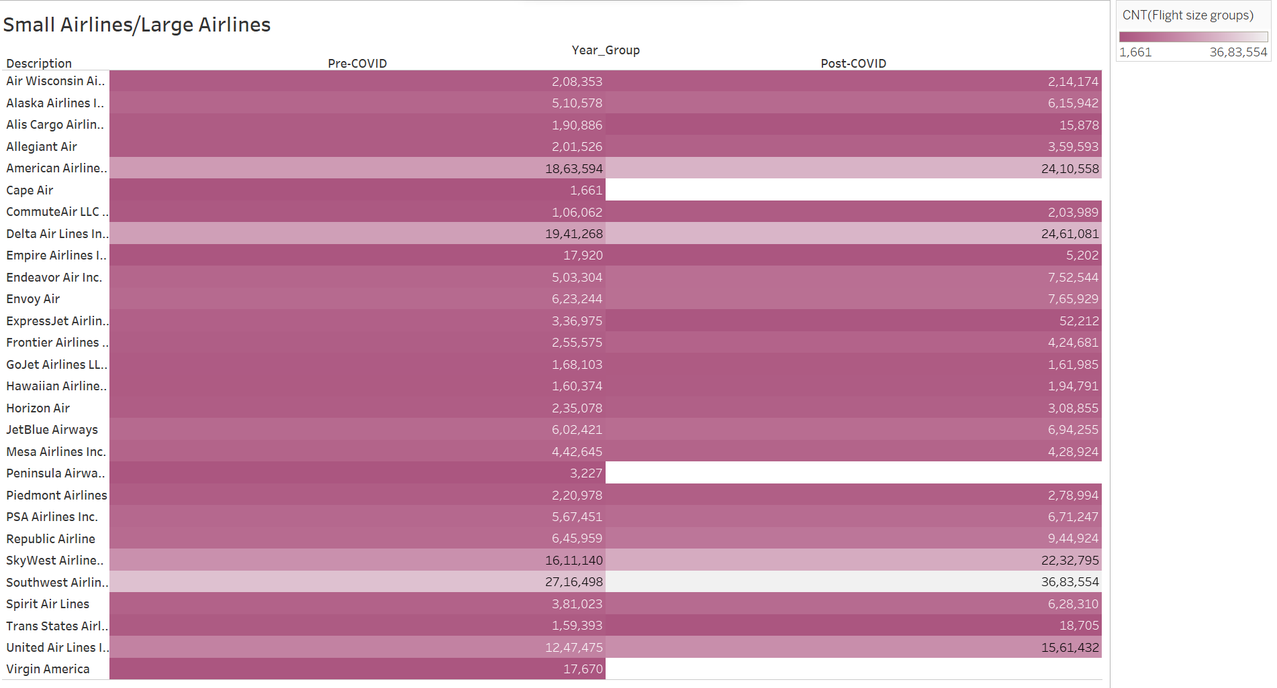
Understanding The Data- Identifying The Operating Airlines In Scope
Small Airlines
Horizon Air
Piedmont Airlines
Alaska Airlines Inc.
Frontier Airlines Inc.
Hawaiian Airlines Inc.
Spirit Air Lines
Mesa Airlines Inc.
CommuteAir LLC dba CommuteAir
GoJet Airlines LLC d/b/a United Express
Air Wisconsin Airlines Corp
6
Notes:
Explain how the small airlines have been scoped.
<20,000
Airlines that are not operating anymore
Airlines that are supported by bigger airlines

Slide 7
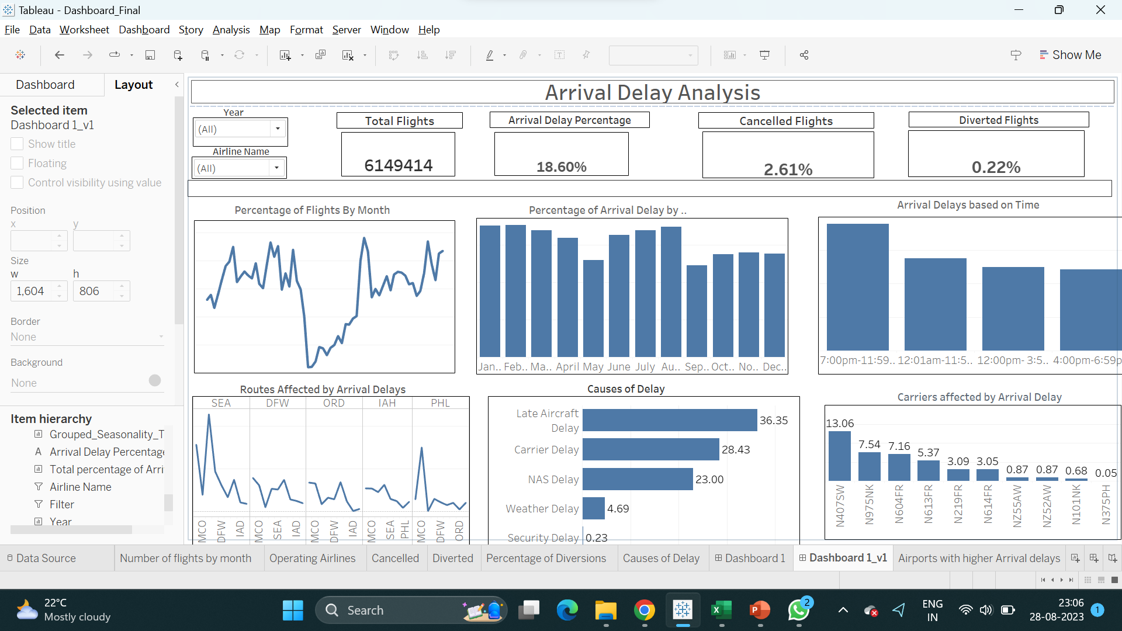
Exploratory Data Analysis
7
Notes:
Explain how the small airlines have been scoped.
<20,000
Airlines that are not operating anymore
Airlines that are supported by bigger airlines

Slide 8
Summary & Insights
-Causes of Delay:-
Late aircraft delays and carrier delays are the primary causes that contribute to the total delay percentages.
Factors that contribute to carrier delay should be analyzed at a more granular level.
Carrier Delay is the only type of delay that can be controlled by the airlines.
-Seasonality( Month and Time):-
The most arrival delays are observed during the February and summer months(June to August), and the least are in September.
The most arrival delays are caused between 7:00 pm and 11:59 pm during late evenings and night.
-Carriers Affected By Arrival Delays:-
Mesa Airlines has the most arrival delays, followed by Spirit and Frontier.
The notable entry is for Commute Air, which has fewer flights than these airlines but is still in the top 10.
8

Slide 9
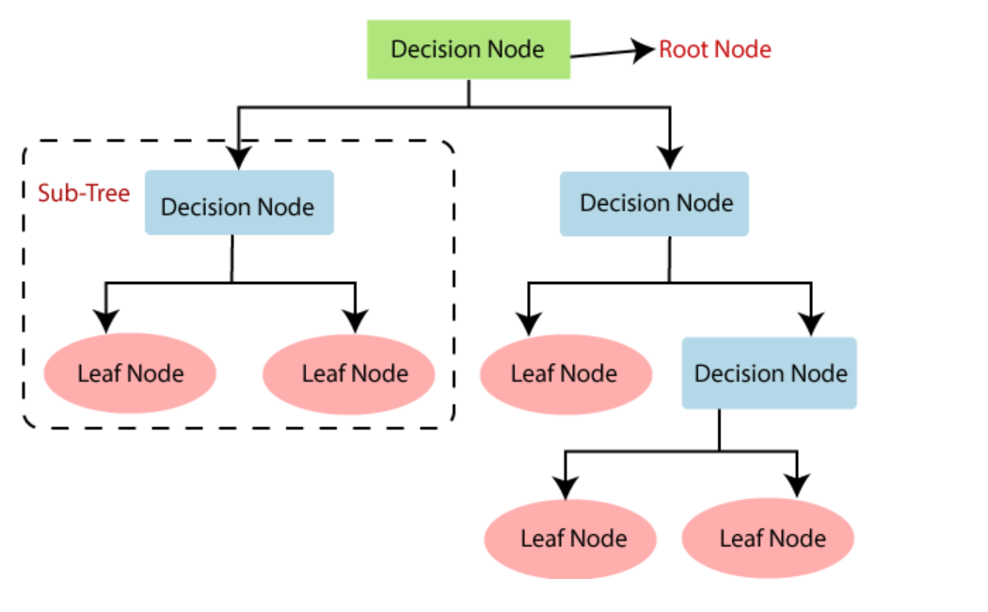
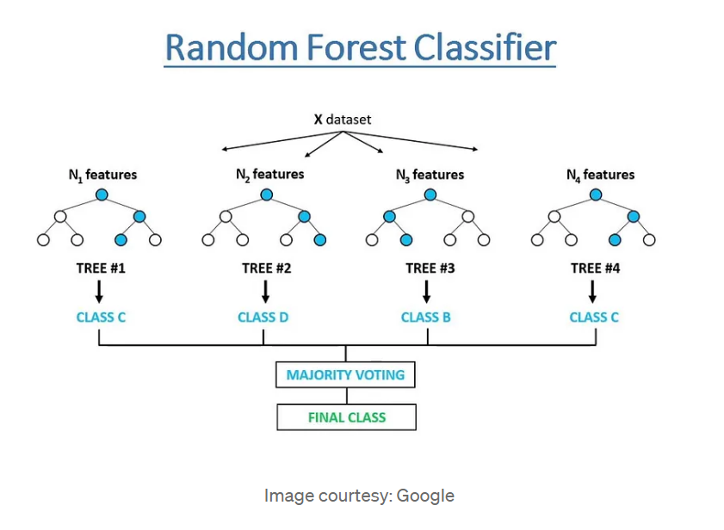
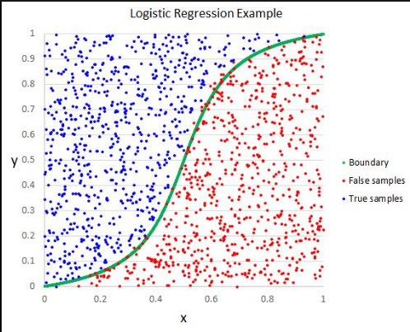
Building The Predictive Model
6 different models were run
Decision Tree Classifier
Bagged Tree
Random Forest Classifier
Logistic regression
XGBoost
Naïve Gaussian
CatBoost Classification Algorithm.
A confusion matrix was used to evaluate the models.
9

Slide 10
Predictive Modeling- Approach
Handling Data
Splitting the data into pre-covid and post-covid.
Covid year (2020) has fewer delays and fewer flights. So, we excluded it from our model.
Class Imbalance:-
This is handled by assigning class weights for our best model.
Model improvement:-
To improve the model’s performance, we have not used specific techniques like Hyperparameter tuning due to low computational power machines.
10

Slide 11
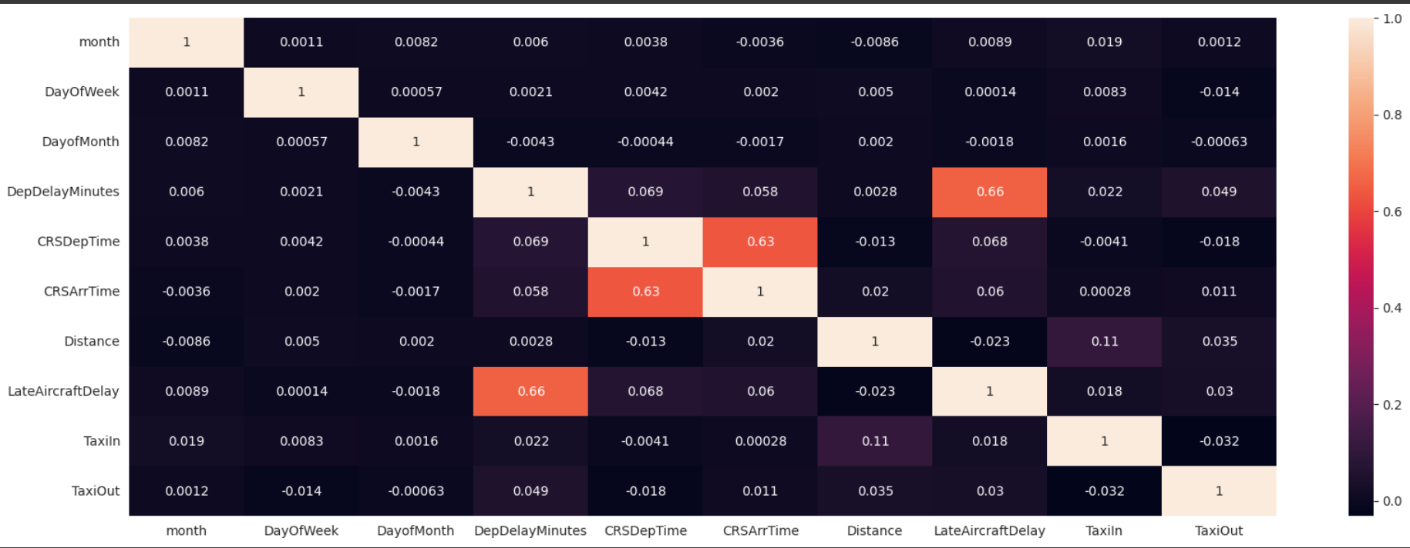
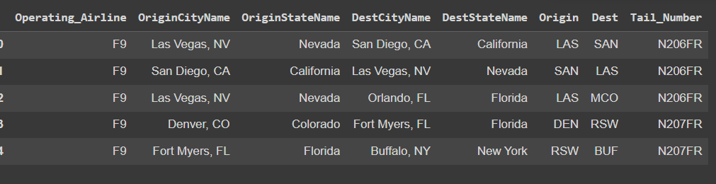
Predictive Modeling- Variable selection
- Numerical and Categorical Variables used as model input
11

Slide 12
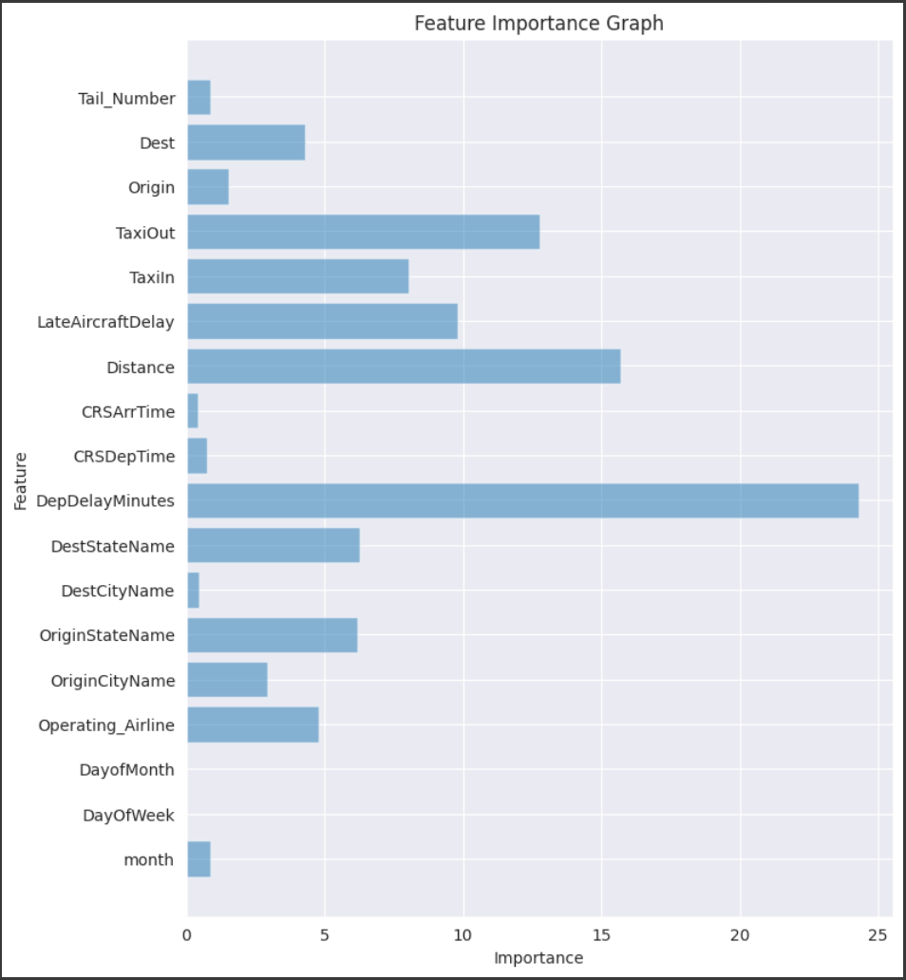
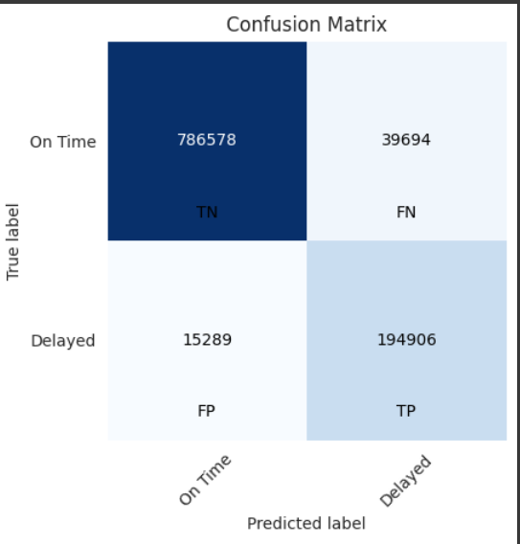
Predictive Modeling- Evaluation
Accuracy | 0.946952
Precision | 0.830801
Recall | 0.927263
f1_score | 0.876386
12

Slide 13
Conclusion,Limitations and Recommendations
Summary:
Based on the important features, we further need to run the models based on a validation set.
The model can further be improved by using data specific to the airline with more specific details e.g., details about the ground staff.
Focus more on areas that are under the control of airlines.
Limitations:
Low computational power in machines
Unavailability of precise data, e.g., ground staff.
No validation dataset to make predictions.
No data specific to airlines that is more granular.
Recommendations:
Airlines can focus on controlling Carrier Delays.
Most airlines have carrier delays of more than 28%, so increase ground staff and fix issues faced by ground staff.
13

Slide 14
Sources
“Airline On-Time Statistics and Delay Causes.” Bureau of Transportation Statistics, www.transtats.bts.gov/OT_Delay/OT_DelayCause1.asp?20=E. Accessed 21 Aug. 2023.
Alaska Airlines. “Virgin America Is Now Part of Alaska Airlines.” Alaska Airlines, www.alaskaair.com/content/travel-info/alaska-vx/flight-plan. Accessed 30 July 2023.
Beheshti, Nima. “Guide to Confusion Matrices & Classification Performance Metrics.” Medium, Towards Data Science, 10 Feb. 2022, towardsdatascience.com/guide-to-confusion-matrices-classification-performance-metrics-a0ebfc08408e
“Cape Air.” Cape Air - AirlinesHQ.Com, airlineshq.com/airlines/usa/cape_air/index.htm. Accessed 30 July 2023.
“Empire Airlines.” AvStop.Com, avstop.com/history/historyofairlines/empire_airlines.htm. Accessed 30 July 2023.
Loh, Chris, and Luke Bodell. “The Rise and Fall of Bombardier Aerospace.” Simple Flying, 21 July 2023, simpleflying.com/bombardier-aerospace/.
14

Slide 15
Citations
“On-Time : Marketing Carrier On-Time Performance (Beginning January 2018).” Bureau of Transportation Statistics, www.transtats.bts.gov/DL_SelectFields.aspx?gnoyr_VQ=FGK&QO_fu146_anzr=b0-gvzr. Accessed 21 Aug. 2023.
“Peninsula Airways - Penair.” AirlinesInfocare, www.airlinesinfocare.com/regional-and-domestic-airlines/peninsula-airways.html. Accessed 30 July 2023.
“Peninsula Airways Inc.” Bloomberg.Com, www.bloomberg.com/profile/company/0008755D:US#xj4y7vzkg. Accessed 30 July 2023.
Silk, Robert. “Trans State Airlines to Cease Operations.” Travel Weekly, 25 Feb. 2020, www.travelweekly.com/Travel-News/Airline-News/Trans-State-Airlines-to-cease-operations.
Sloan, Chris. “Airbus Delivery Delays Stymie Frontier’s Capacity Growth Plan.” Aviation Week Network, 9 Feb. 2023, aviationweek.com/air-transport/airlines-lessors/airbus-delivery-delays-stymie-frontiers-capacity-growth-plan.
“U.S. Passenger Carrier Delay Costs.” Airlines For America, www.airlines.org/dataset/u-s-passenger-carrier-delay-costs/#:~:text=In%202022%2C%20the%20average%20cost,percent%20to%20%2428.99%20per%20minute. Accessed 28 Aug. 2023.
15

Slide 16
Citations
Wildes, Michael. “ExpressJet Files Chapter 11 Bankruptcy, Furloughs 1,300 Pilots.” FLYING Magazine, 24 Aug. 2022, www.flyingmag.com/expressjet-files-chapter-11-bankruptcy-furloughs-1300-pilots/.
Wolfsteller, Pilar. “Compass Airlines to Shut down Operations.” Flight Global, 19 Mar. 2020, www.flightglobal.com/strategy/compass-airlines-to-shut-down-operations/137408.article.
16

Slide 17
Thank You!

Slide 18
Appendix

Slide 19
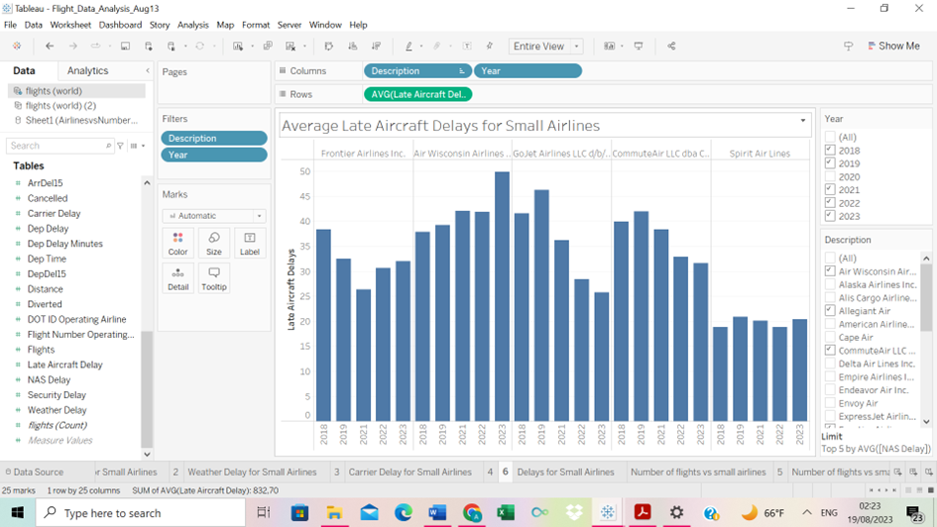
Average Late Aircraft Delays Per Airline
Frontier, Air Wisconsin and GoJet had the most instances of late aircraft delays.
Spirit Airlines had the least aircraft delays.
Notes:
briefly describe late aircraft delays
Can we include an actual dashboard so we can play around with the years if needed?

Slide 20
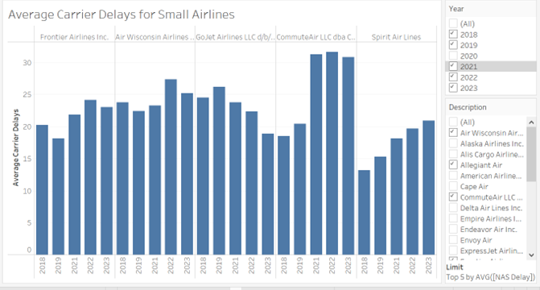
Average Carrier Delays Per Airline
Commute Air had the most carrier delays overtime.
Spirit Airlines had the least delays overtime.
Notes:
Briefly describe carrier delays

Slide 21
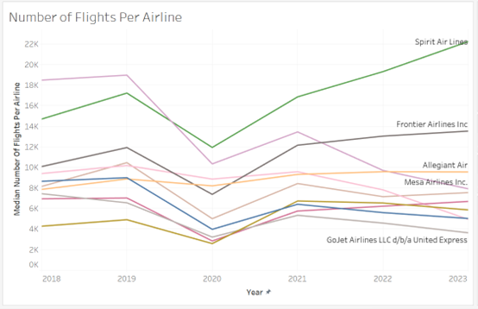
Number of Flights Per Airline
Median number of flights for the top 5 airlines.
Spirit Airlines had the most flights overtime.
Interesting to observe given that they had the least carrier and late aircraft delays.

Slide 22
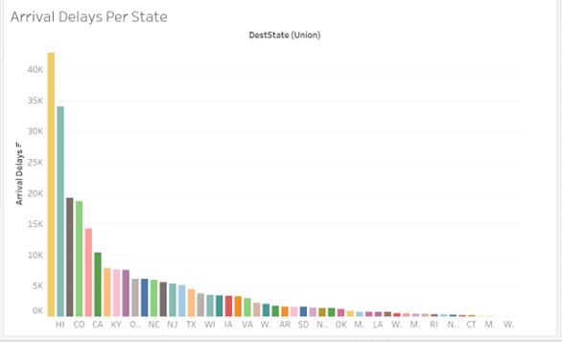
Covid Analysis (Part 2)
Arrival delays per destination state.
Top 5 states
Florida (42 674)
Hawaii (33 981)
Illinois (19 203)
Colorado (18 657)
Nevada (14 240)

Slide 23
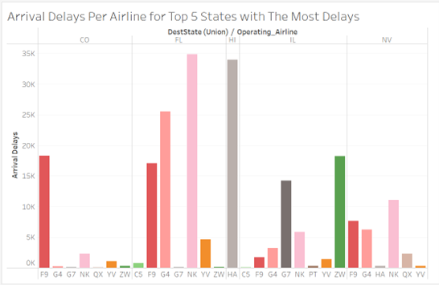
Covid Analysis (Part 2)
Arrival delays with respect to operating airlines
Florida and Illinois have the most delays.
Nevada and Colorado have the least delays.
Most delays in Colorado come from Frontier.

Slide 24
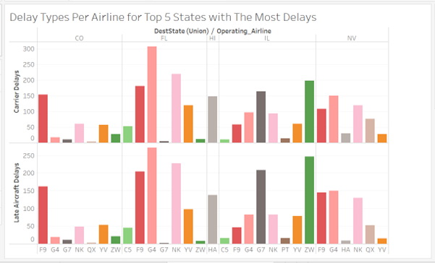
Covid Analysis (Part 2)
Instances of different delay types for each airline.
Frontier (F9), Allegiant Air (G4) and Spirit Airlines (NK) stand out.

Slide 25
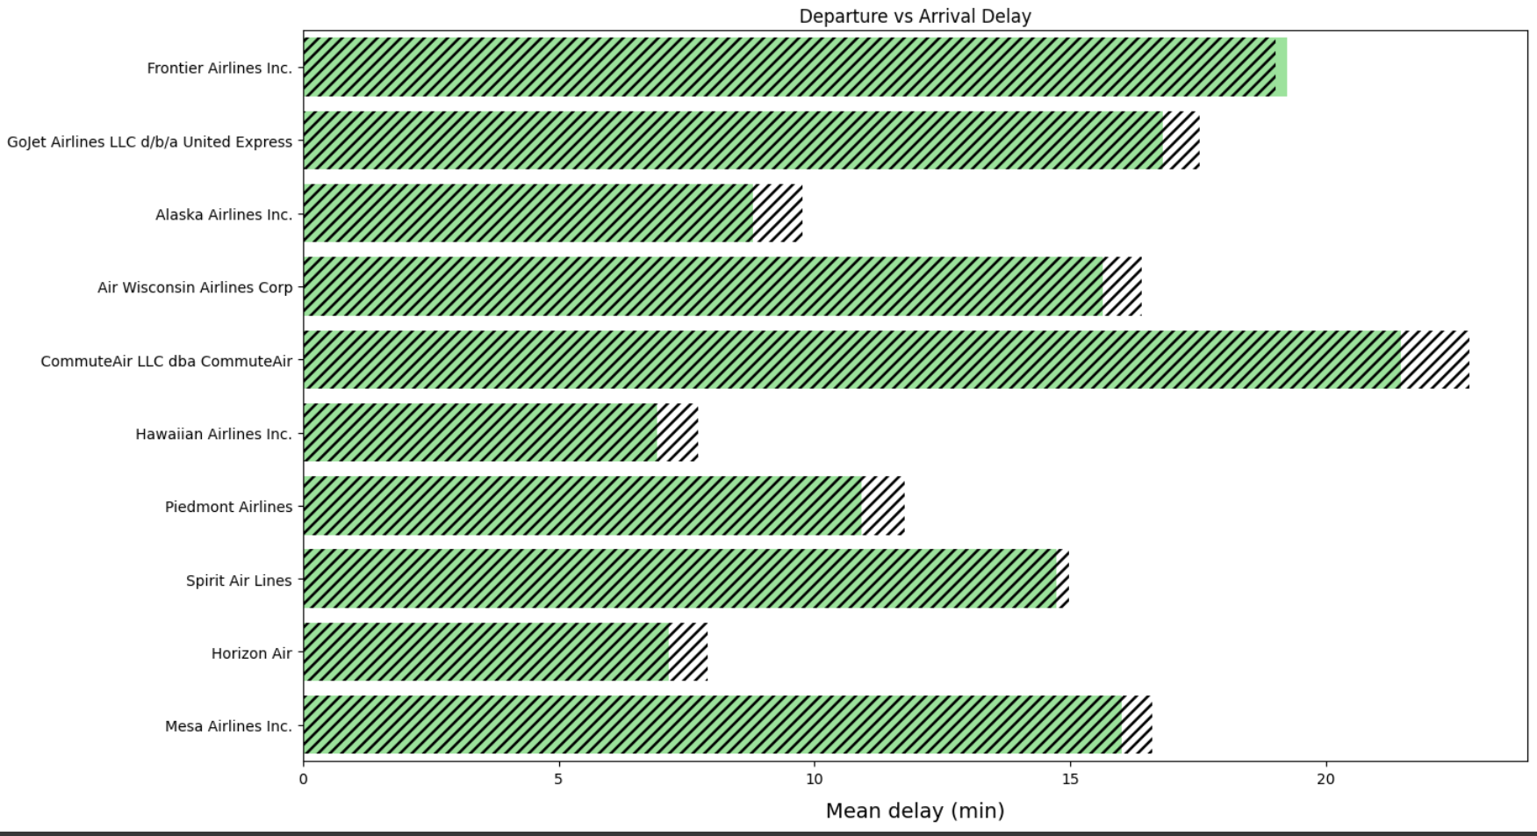
Departure Delay vs Arrival Delay
Comparing the departure delay and arrival delay for each of the airlines.
The green shaded part represents the departure delay and this shows that Frontier airline has more departure delays than arrival delays which means they manage to cover the delayed departure time always.

Slide 26
Model Updates
Plan of action as per the last week
Exploring Additional Features through Variable Combinations:
Our next focus in the analysis is to identify various combinations of variables that can be utilized to generate additional features.
Standardizing Numeric Columns:
We will standardize the numerical columns that we have considered in our study.
Identifying Important Key Column Variables:
We will conduct a thorough analysis of important column variables that require consideration.
Model Testing and Selection:
Various models will undergo testing and we will determine the best-performing one for our needs.

Slide 27
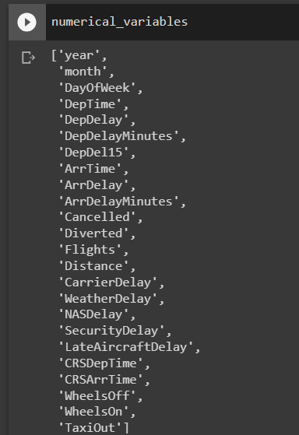
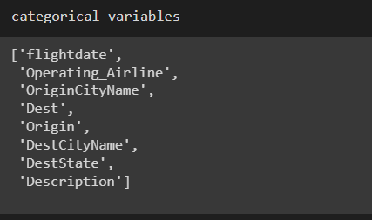
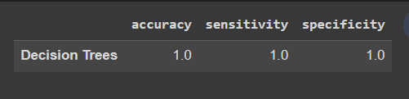
Model Updates- Model execution(Failure)
Using the Decision Trees algorithm to do the ML model.
After model execution when we calculated the confusion matrix the sensitivity and specificity for the model is coming out as 1. This clearly states that the model is overfit.

Slide 28
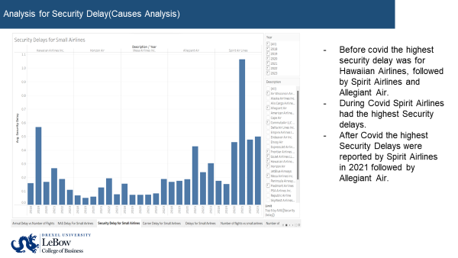

Slide 29
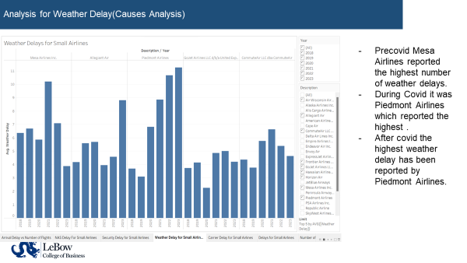

Slide 30
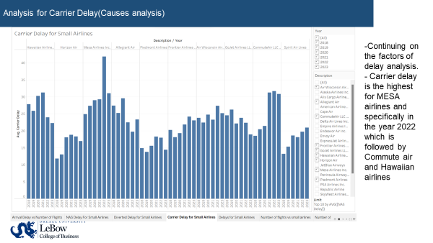

Slide 31
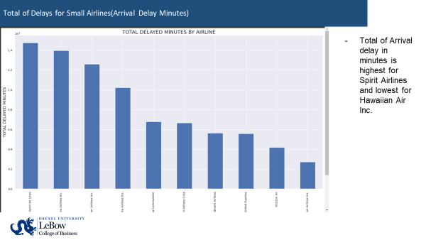

Slide 32
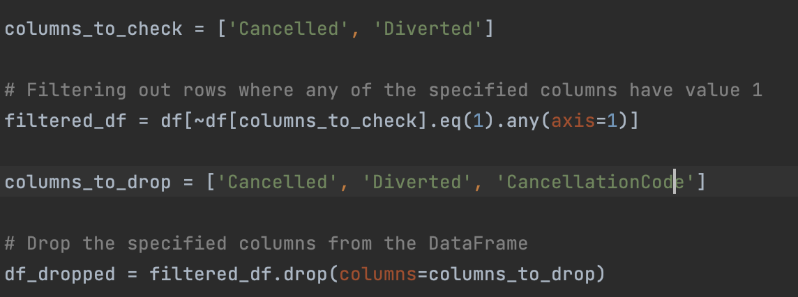
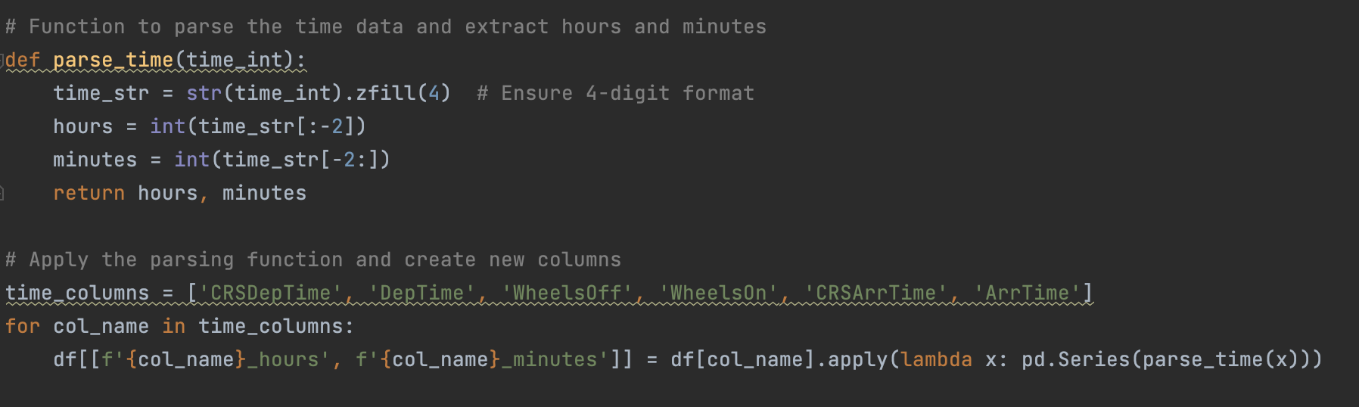
Predictive Model - Data Preparation
Removing rows where these columns have values
Step.1.
Parsing Time data columns in order to use them in Models
Step.2.

Slide 33
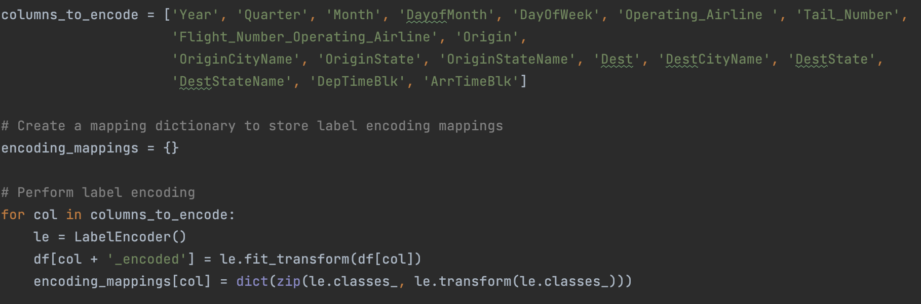
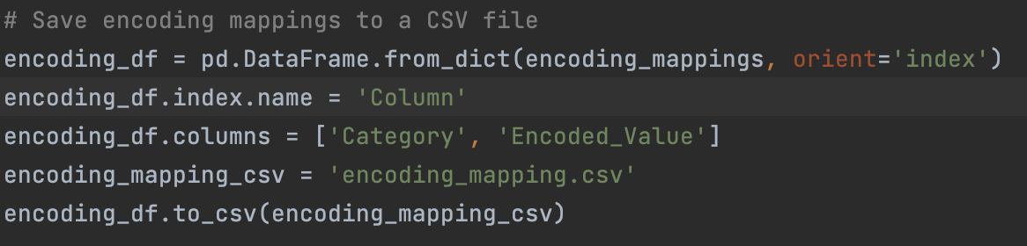
Predictive Model - Data Preparation
Performing Label Encoding to the categorical columns
Step.3.
Creating encoding mappings csv file for future reference
Step.4.

Slide 34
Predictive Model - Machine Learning
Objective
Predicting flight delays is crucial for both airlines and passengers. For airlines, it enables better resource allocation, improved customer service, and optimized operations. For passengers, it allows for better planning and a more pleasant travel experience.
Challenges Faced
Data Size: Handling large datasets can be computationally intensive and requires efficient data processing techniques.
Overfitting: Several models, like GaussianNB and Logistic Regression, showed signs of overfitting, characterized by exceptional training performance but potential poor generalization to new data.
Feature Selection: Deciding which features to include in the model can significantly impact performance. Irrelevant or redundant features can degrade the model's performance.

Slide 35
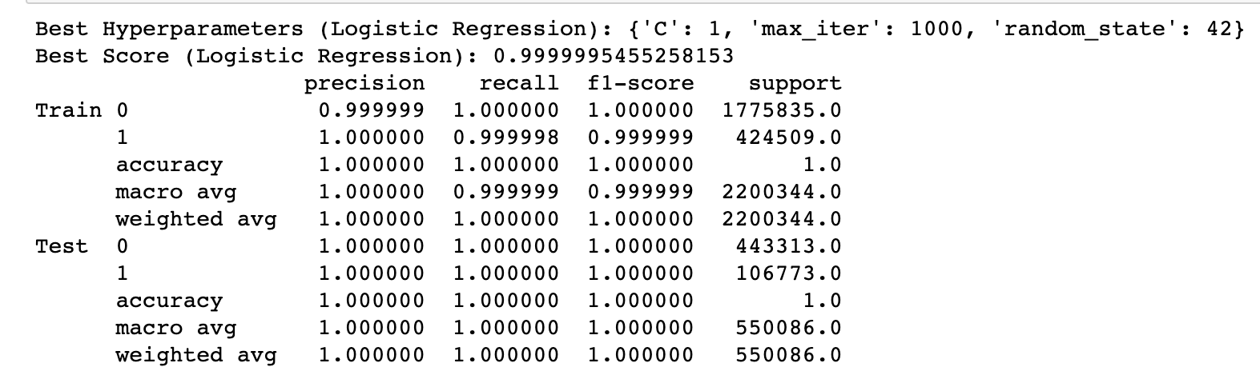
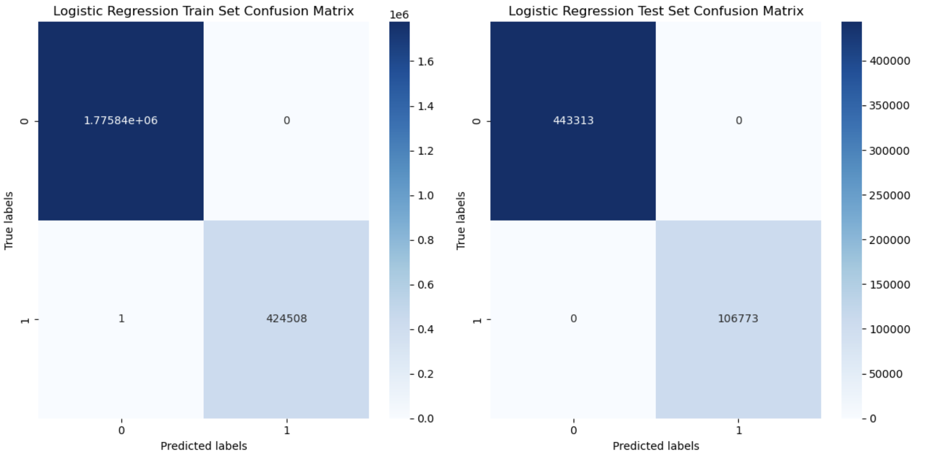
Logistic Regression Model Results
Performance Metrics :-
Accuracy (Train): 100%
Accuracy (Test): 100%
Precision, Recall, F1-Score for each class indicating near-perfect classification.
Conclusion :-
The Logistic Regression model achieved an almost perfect score. This could indicate a very strong linear relationship or potential overfitting.
Best Hyperparameters :-
Regularization Strength (C): 1
Maximum Iterations: 1000
Random State: 42

Slide 36
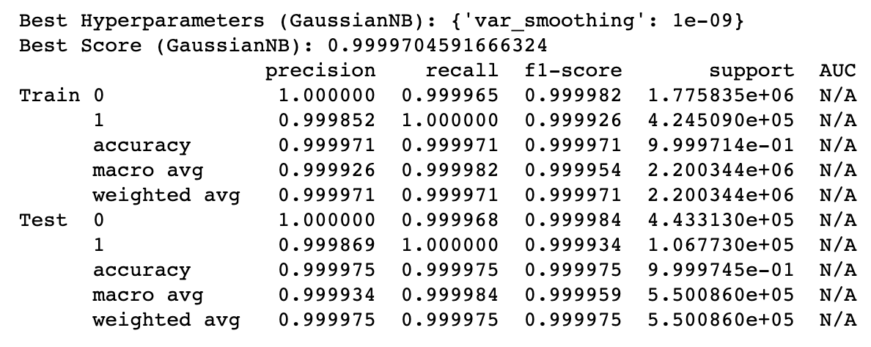
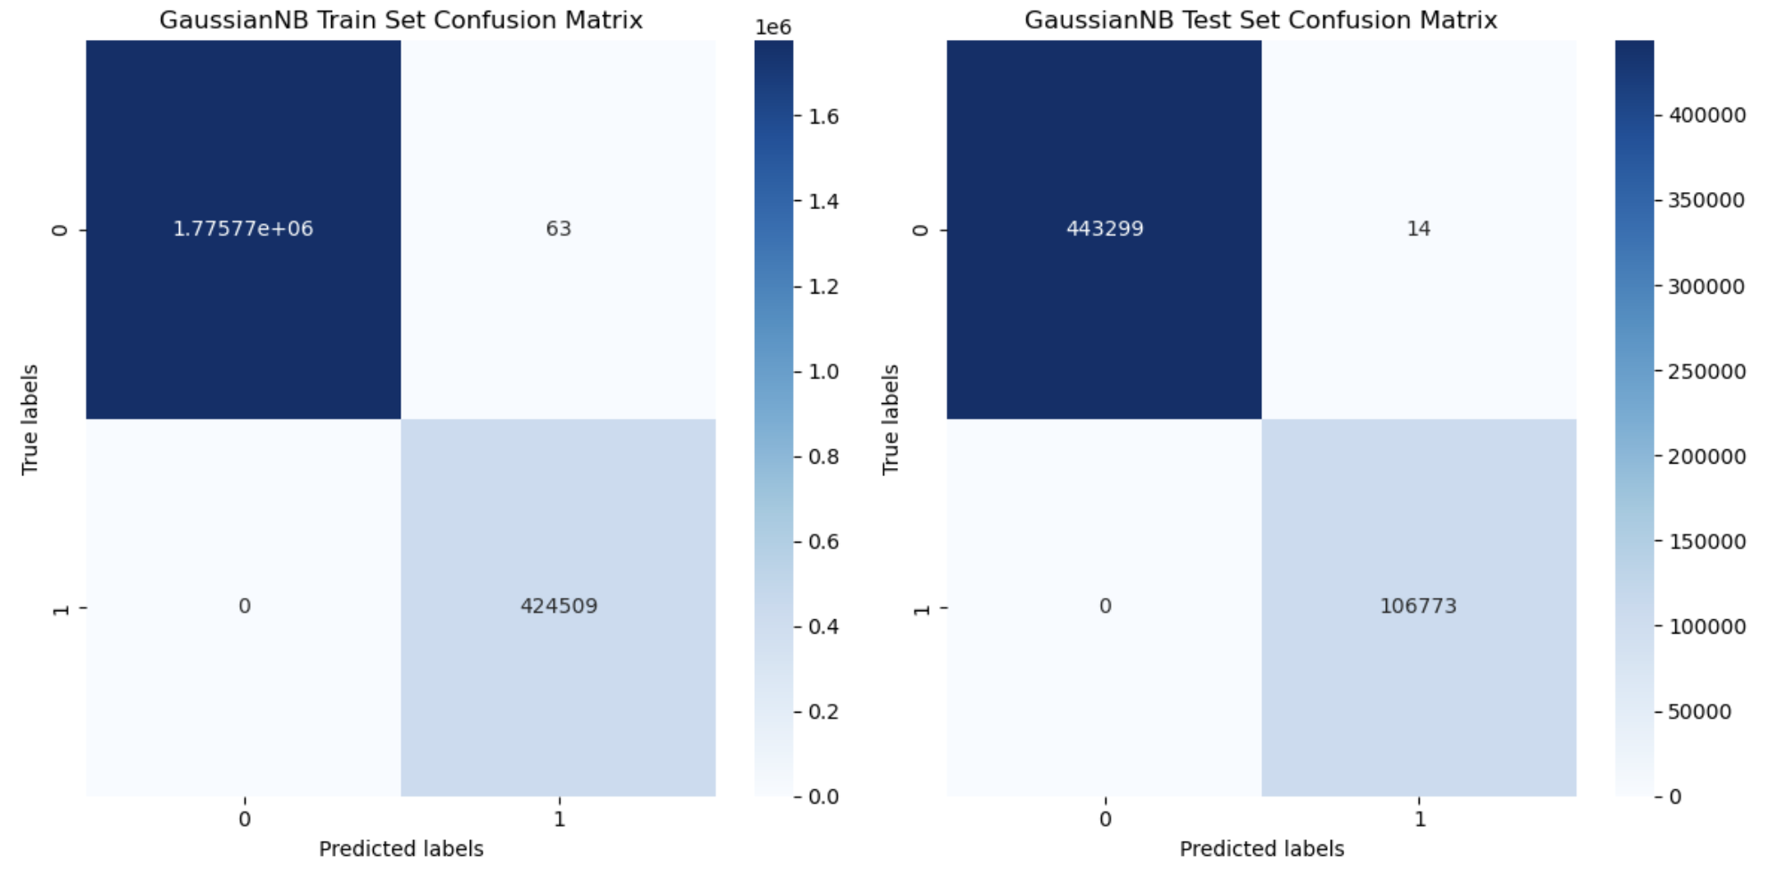
Gaussian Naive Bayes Model Results
Performance Metrics :-
Accuracy (Train): 100%
Accuracy (Test): 100%
Precision, Recall, F1-Score for each class indicating near-perfect classification.
Best Hyperparameters :-
Variance Smoothing: 1e-09
Conclusion :-
The Gaussian Naive Bayes model provided a near-perfect classification.

Slide 37
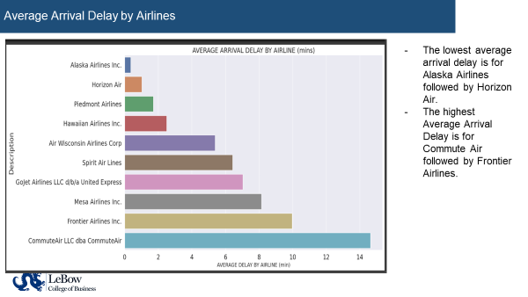

Slide 38
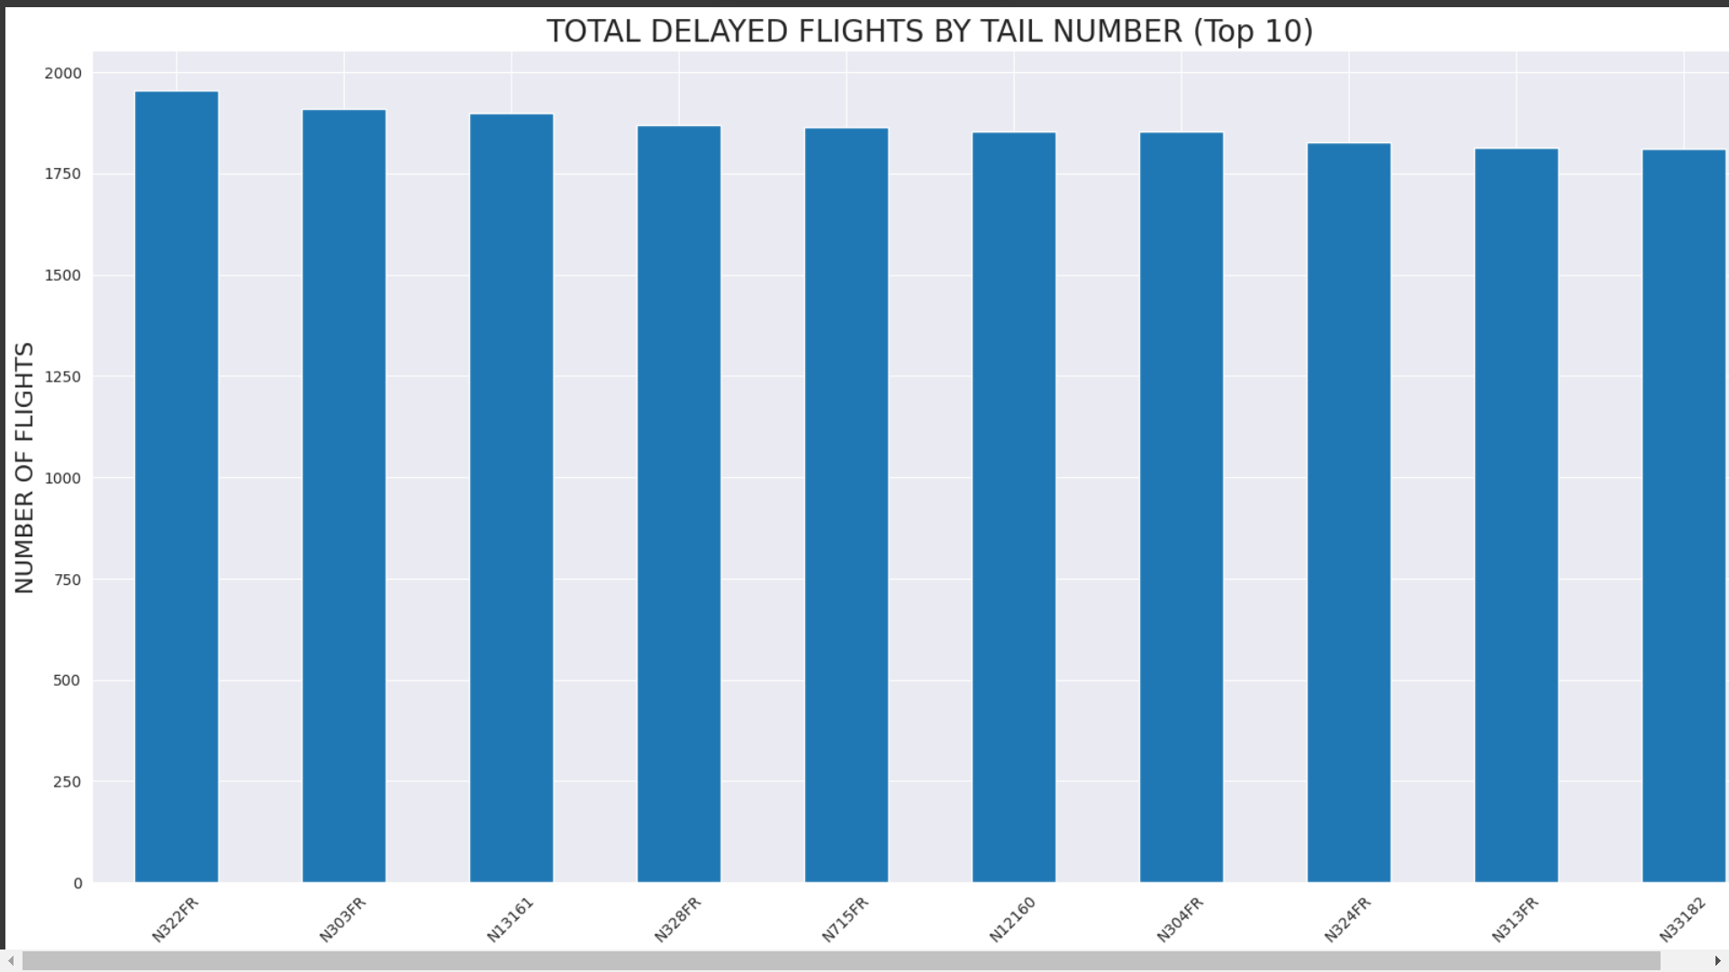
Any Specific Airline who has the most number of Delays?
The Tail numbers here are specifically for Frontier Airlines
The issue is with Airbus and the airlines mentioned that they have been facing issues due to this.

Slide 39
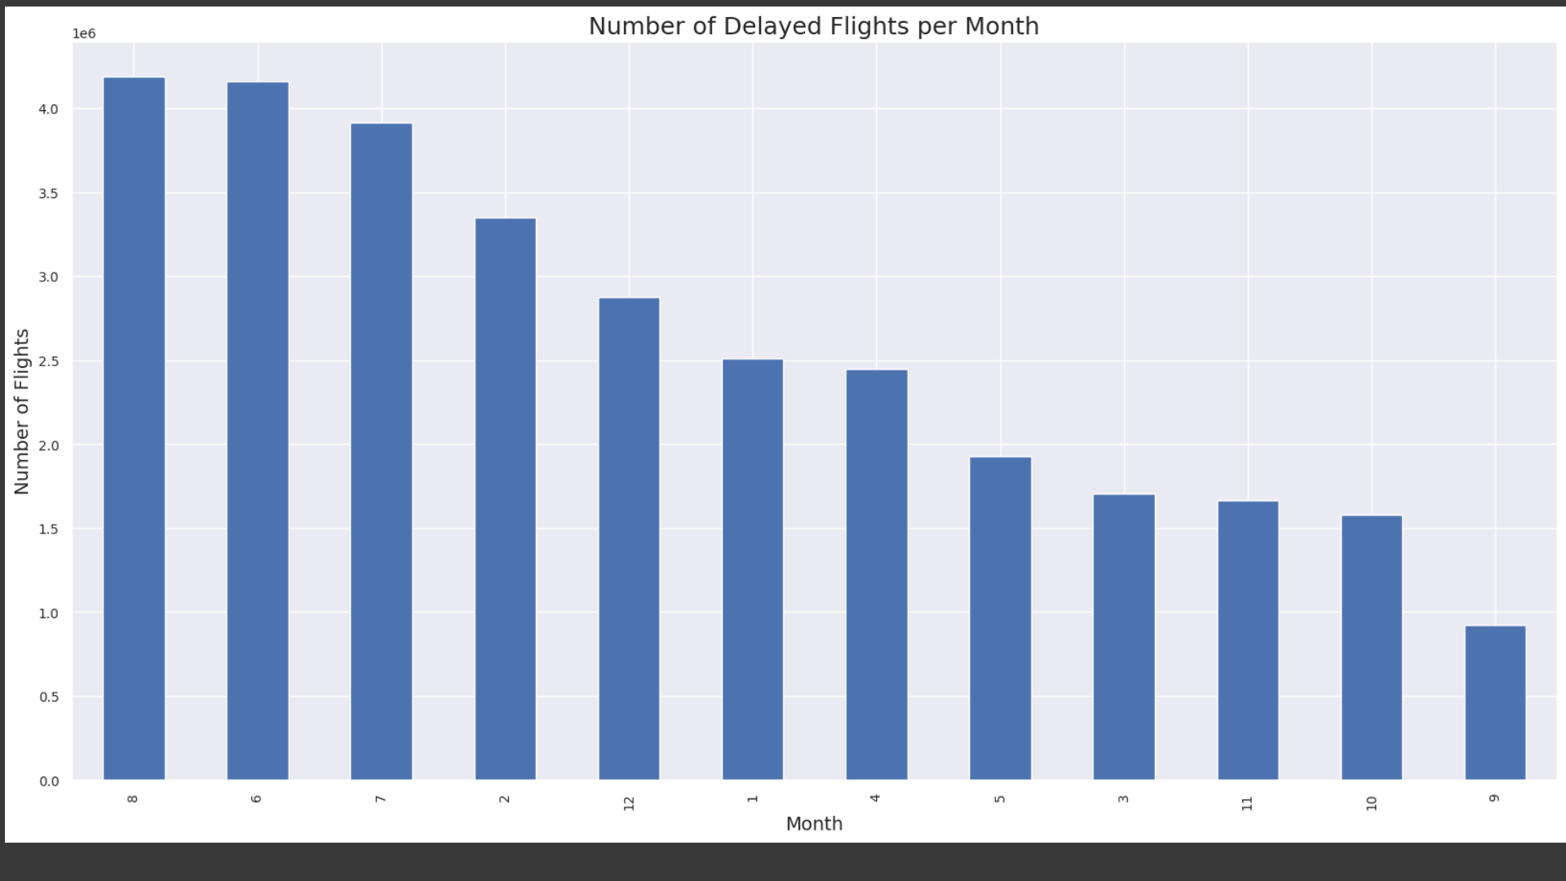
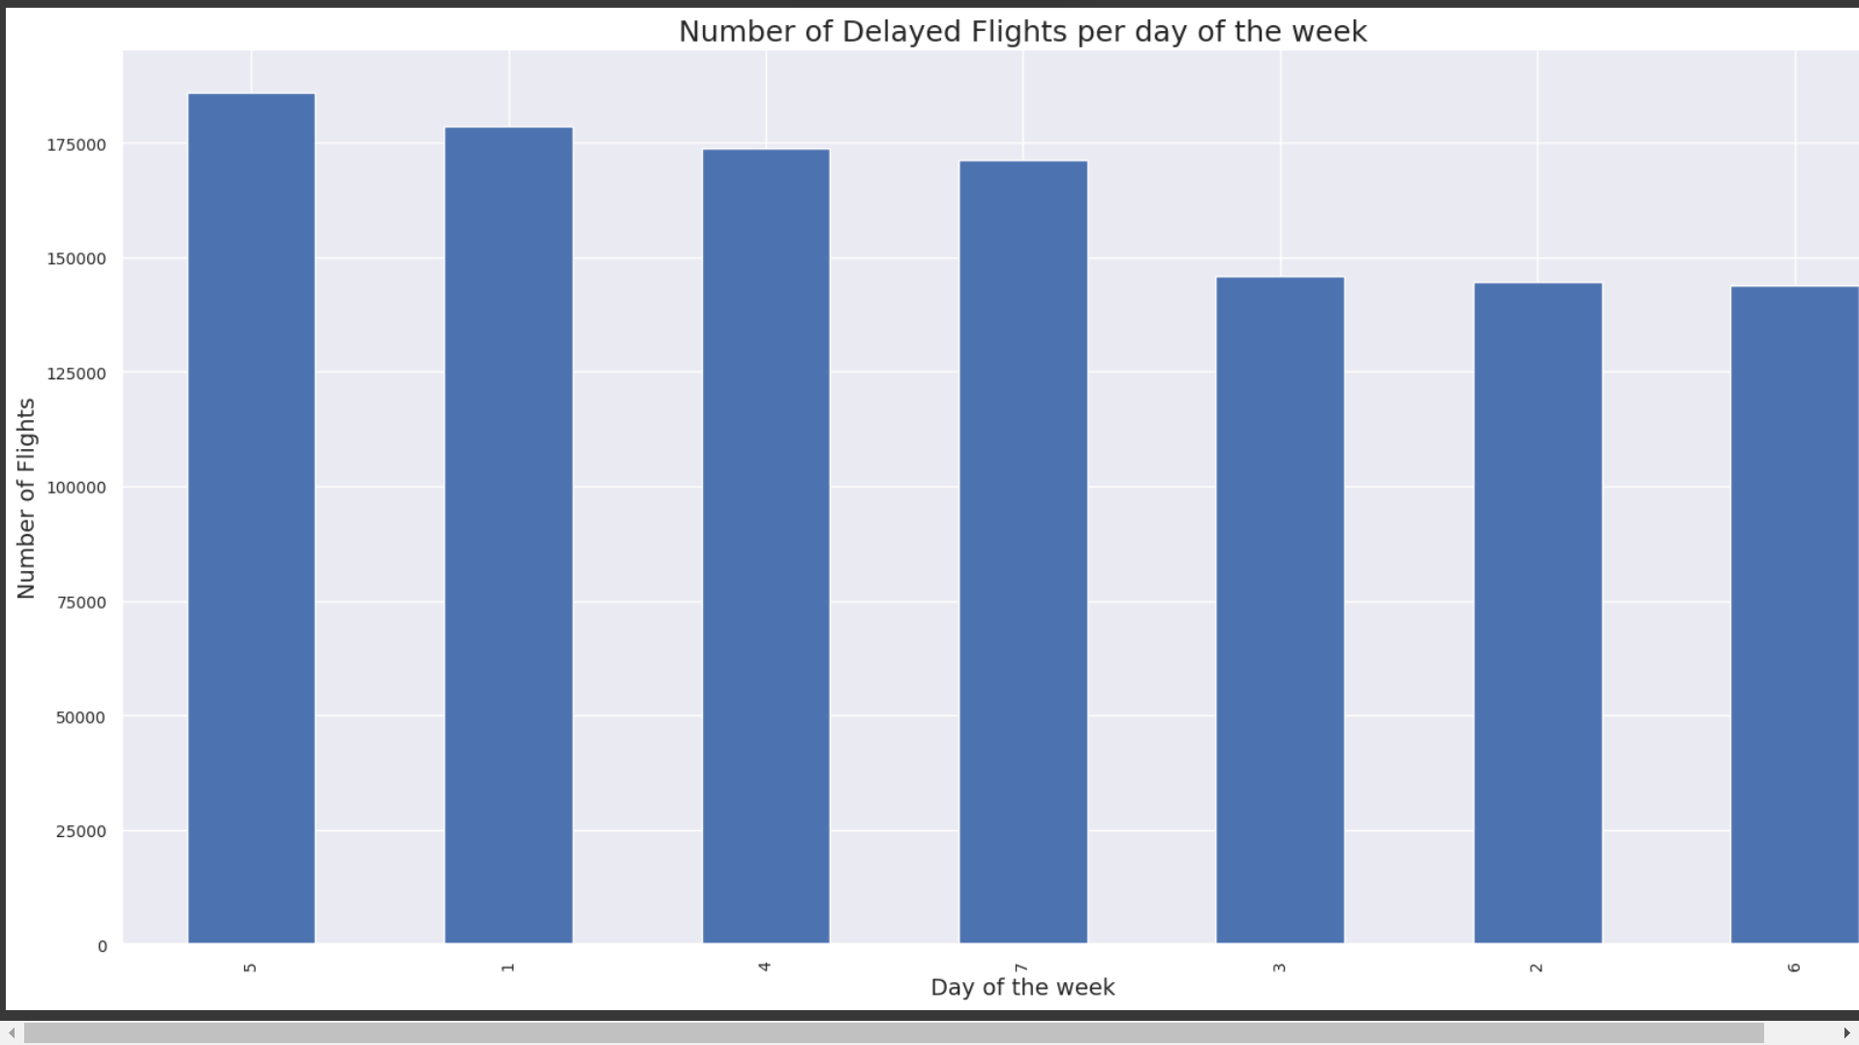
Can we see any Seasonality, Trends for the data in terms of delays?
Worst months to travel/busiest months: June-August (summer months)
Passengers experience the worse delays
Least busy month: September
Start of Fall and milder weather
More flight delays on Fridays and less delays on Saturdays
This could be because more people travel on Fridays for weekend trips
Second highest number of delays-Monday
The new week starts and people are flying back home from weekend trips
Notes:
During summer months, it’s vacation season so passengers experience more/worse delays.
Fall season–weather is mild and skies are clearer

Slide 40
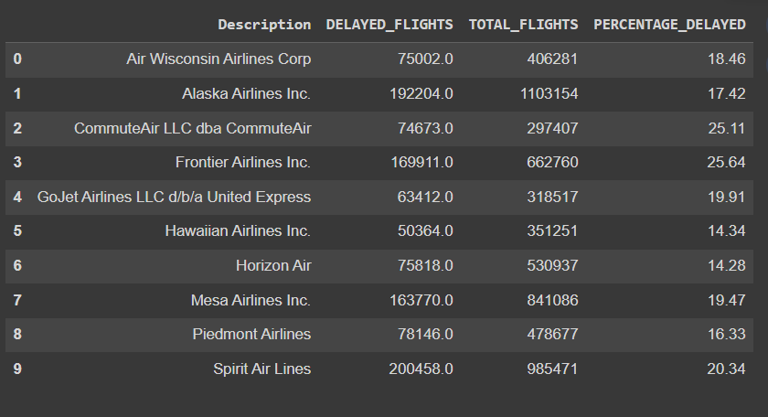
Arrival Delays
-high percentage of delays
-4th highest in number of total flights
-The lowest delay percentage.
-3rd from the bottom in number of flights but still better
Notes:
-high percentage of delay
-4th highest in number of total flights
- Alaska and Spirit Airlines have comparatively better mechanisms to reduce delayed flights
-The lowest delay is for Horizon Air even though they dont have the lowest number of total flights which means they also have good mechanisms in place to manage their delays

Slide 41
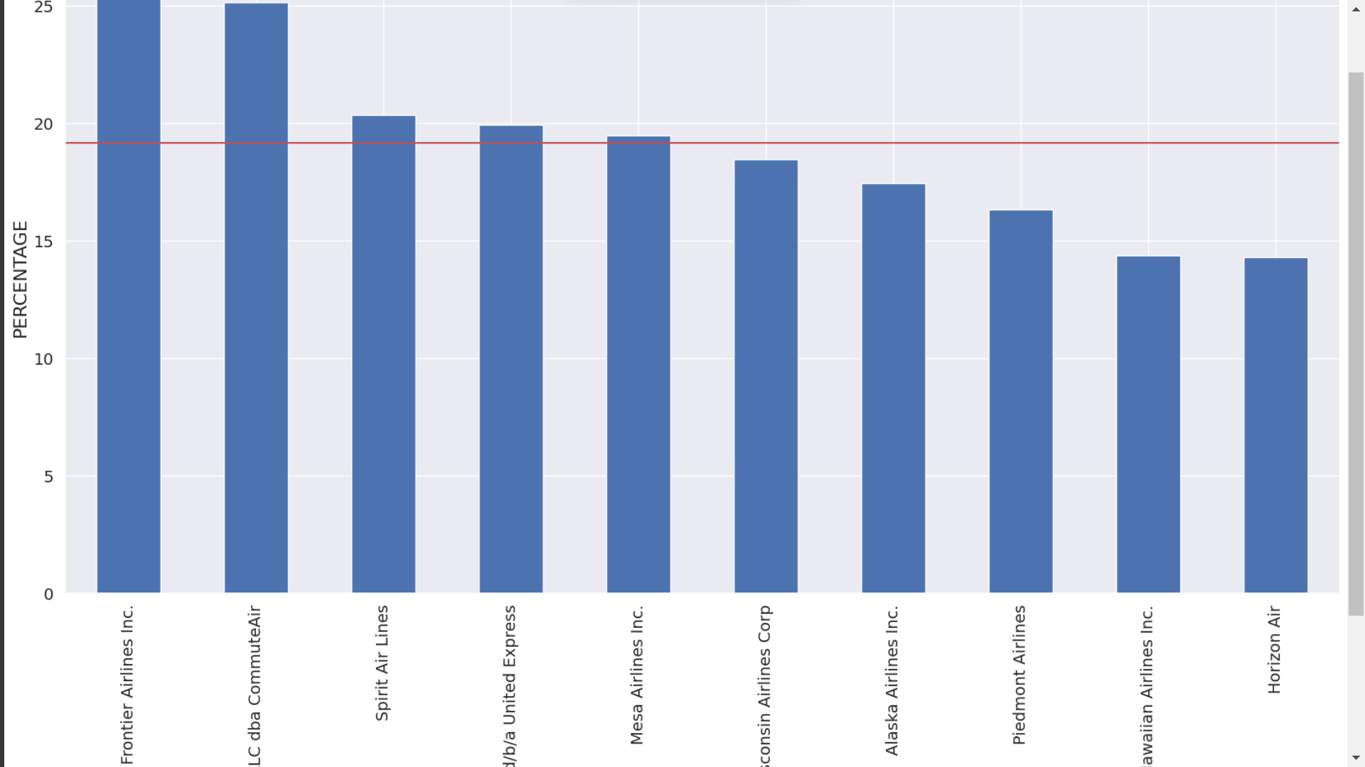
Percentage of Delayed flights Per Airline
Commute Air and GoJet Airlines are now in the top 5
Frontier has the lowest (74.36%)
Horizon Air has the highest (85.72%)
Frontier Airlines ranked 4th in the total number of flights but has the highest number of flight delays amongst them all.
Commute Air has lowest number of flights but is ranking 2nd in terms of delay.
Notes:
The top 5 Airlines by percentage has now changed
Horizon Air has the highest (85.72%)
This is interesting as Horizon Air is 6th in the number of flights list and still has managed to maintain lower arrival delay times.

Slide 42
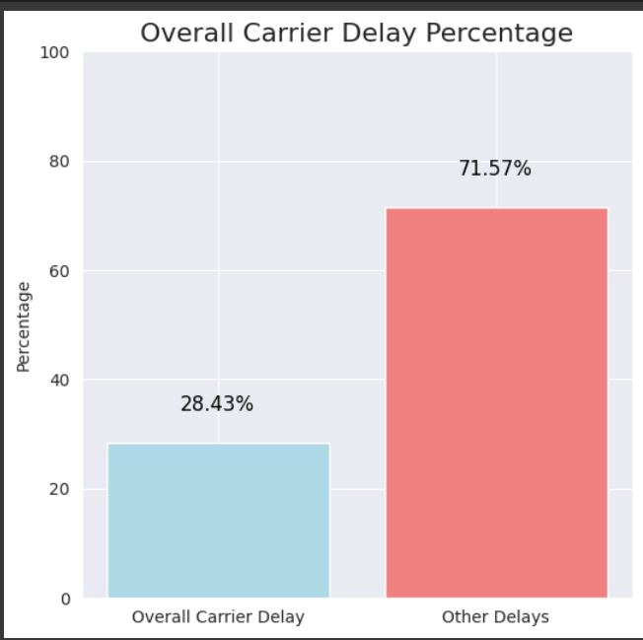
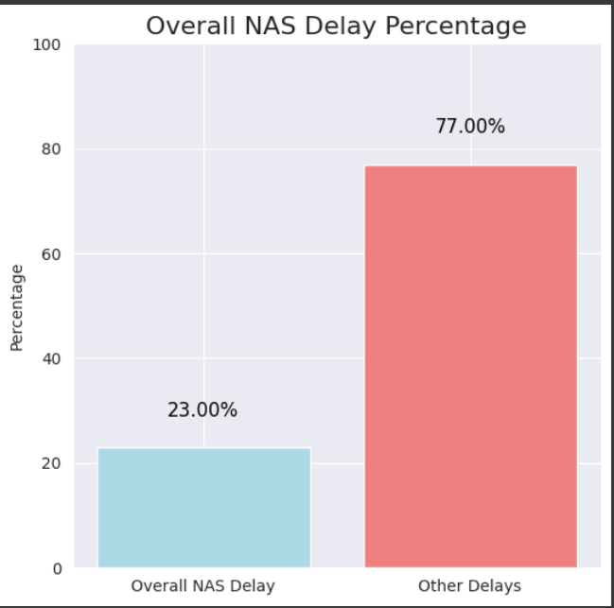
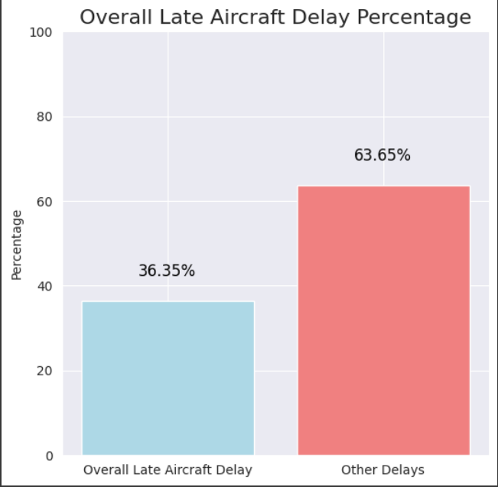
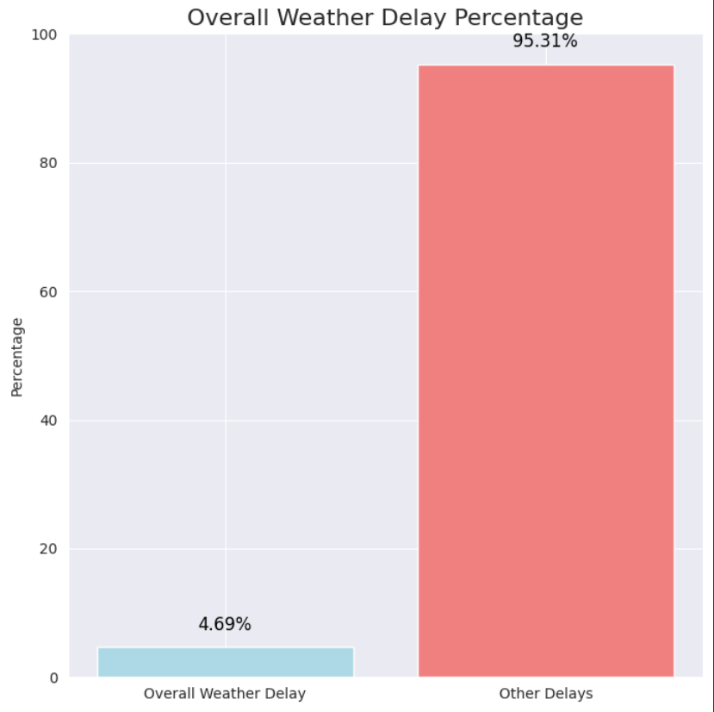
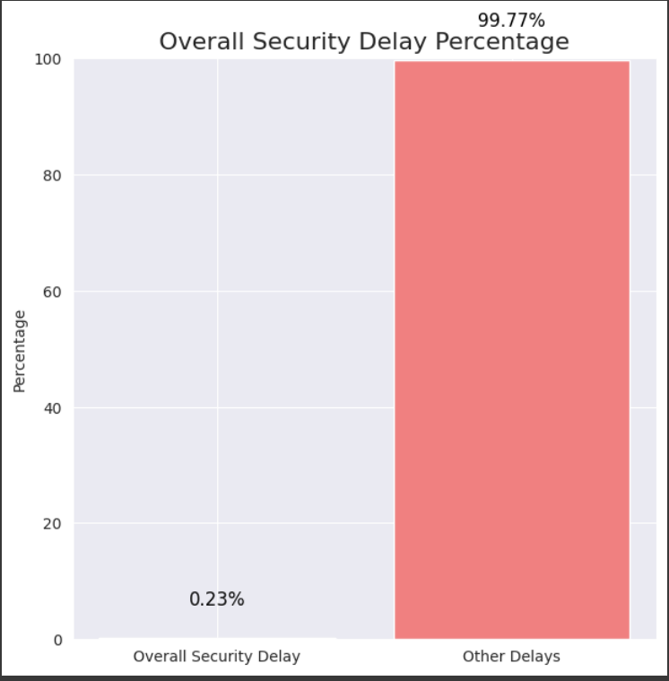
What are the Overall Causes of Delay Percentages?

Slide 43
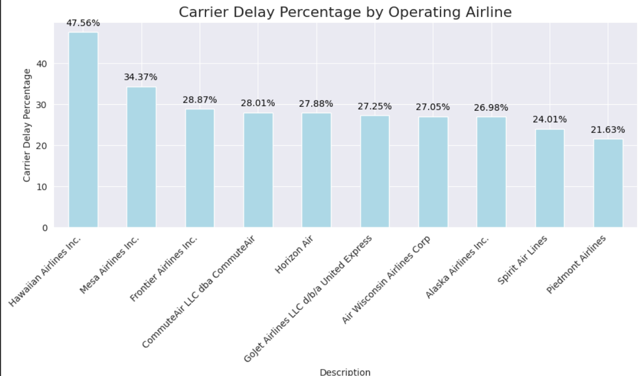
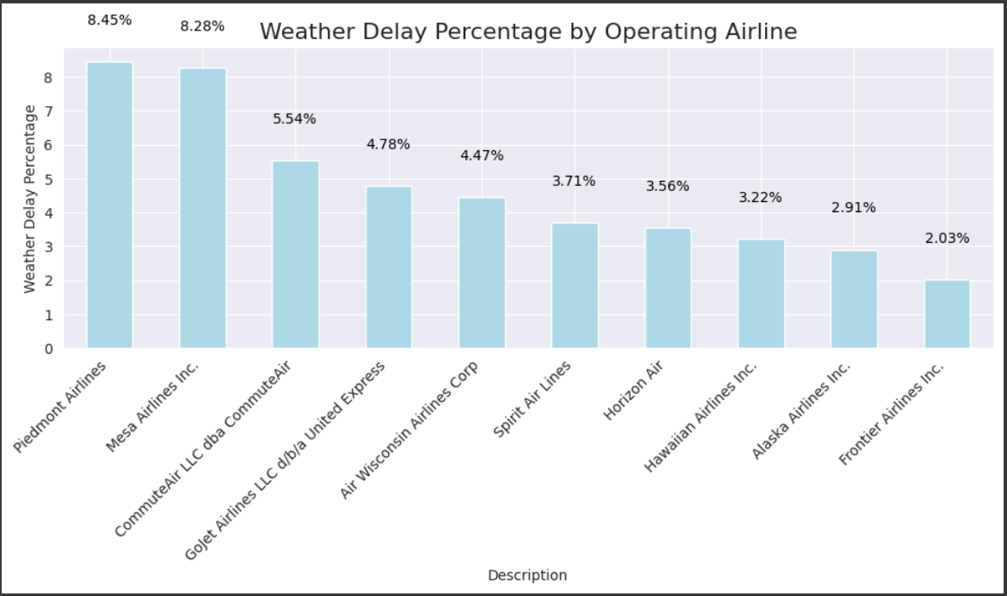
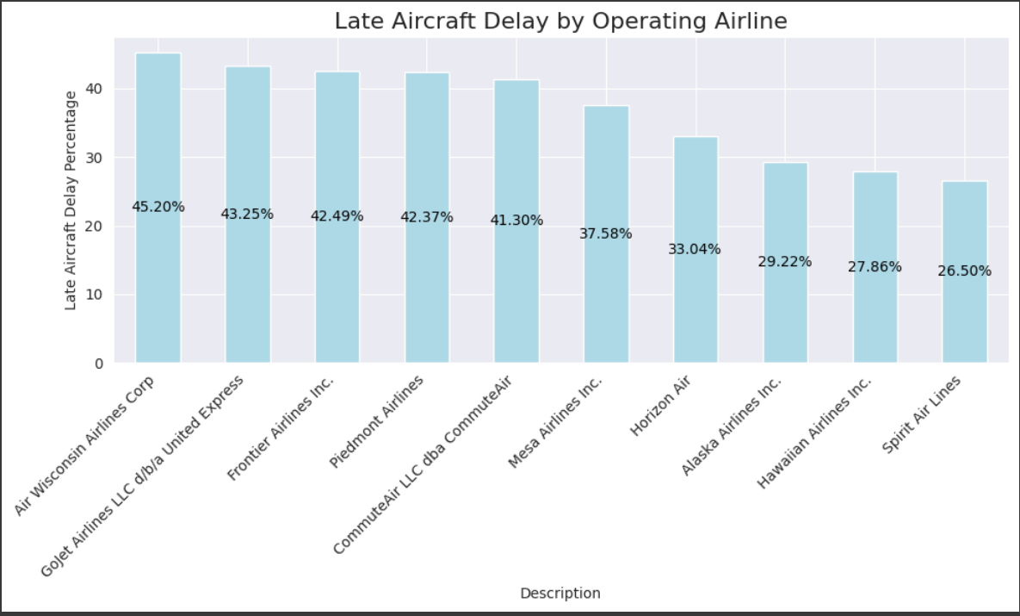
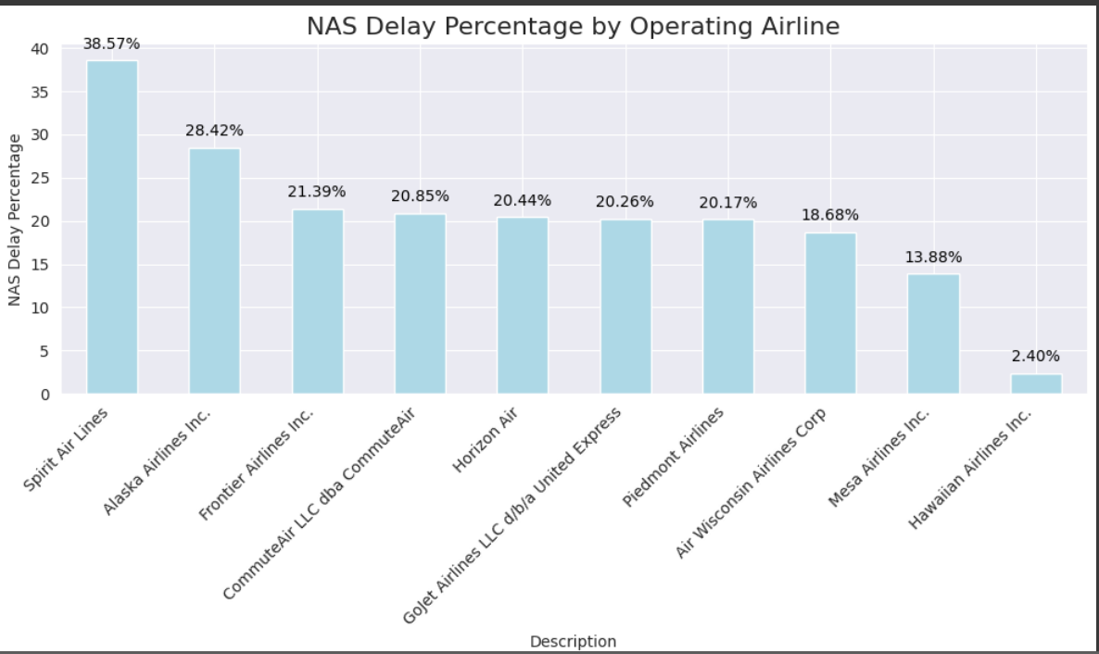
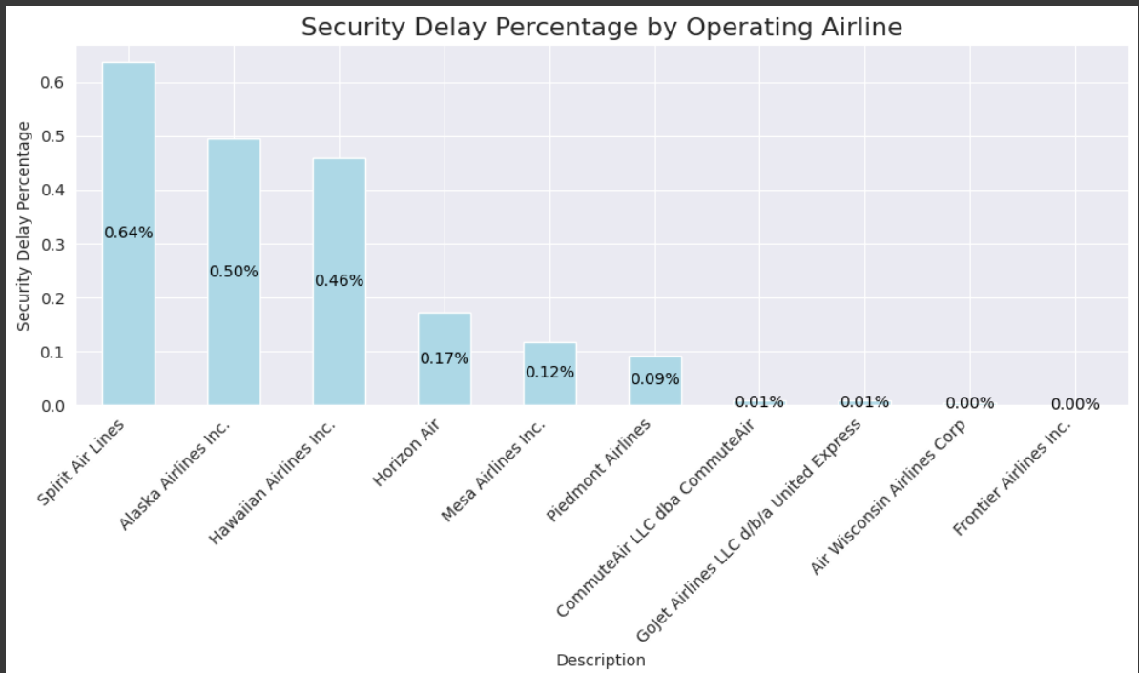
What are the Overall Causes of Delay Percentages for the Small Airlines?

Slide 44
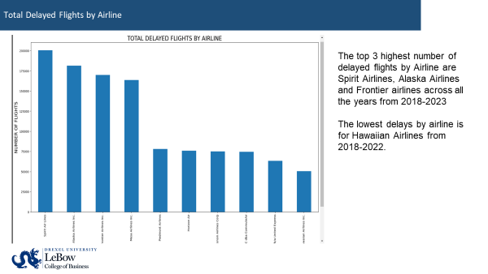

Slide 45
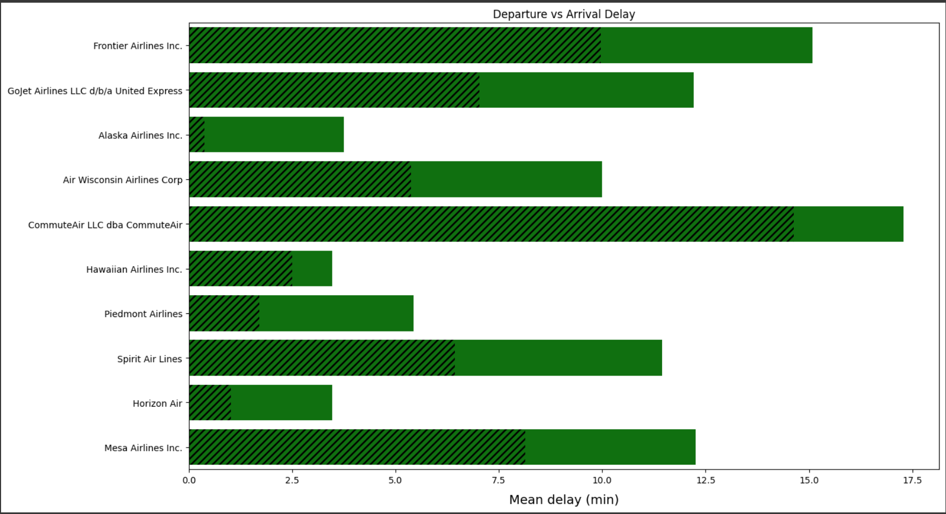
Departure vs Arrival Delays
Least Arrival delays
Most departure delays

Slide 46
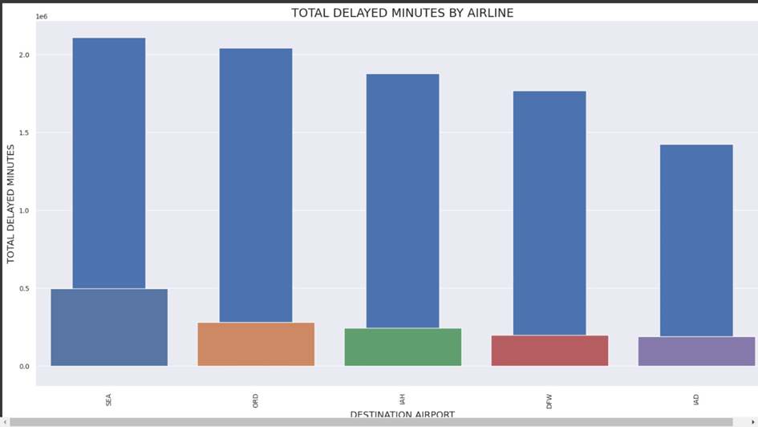
Arrival Delays Per Airport
Top 5 airports with the most delays
Seattle Tacoma (SEA)
Chicago O’Hare (ORD)
George Bush Intercontinental (IAH)
Dallas Fort Worth (DFW)
Dulles International (IAD)

Slide 47




Predictive Modeling- Evaluation (Pre-Covid)
Decision Tree
Random Forest
Logistic Regression
Bagged Tree

Slide 48




Predictive Modeling- Evaluation (Post- Covid)
Decision Tree
Random Forest
Bagged Tree
Logistic Regression

